Slide 1
Lecture 7-1

Slide 2
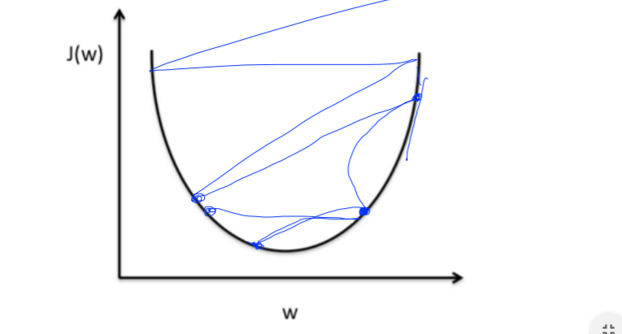
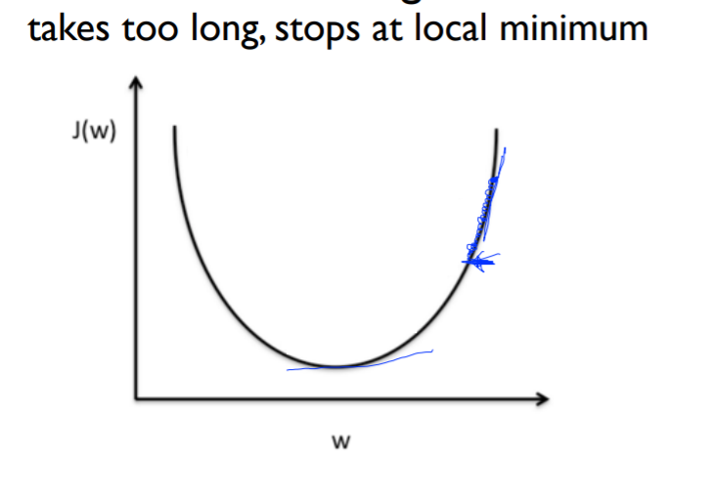
Learning rate : 경험에 의해 잡아야 되는 값
Large learning rate: overshooting
Small learning rate

Slide 3
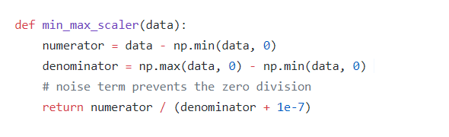
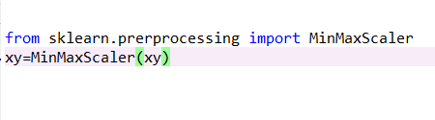
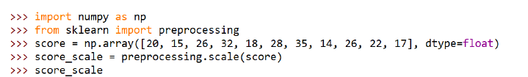
Data preprocessing
Data normalization/standardization
Min-max
Standardization

Slide 4
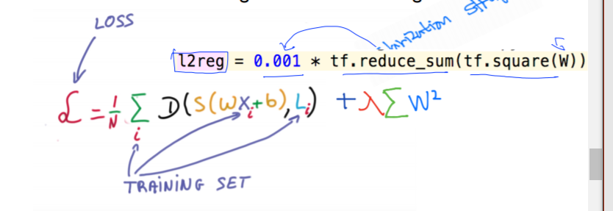
3. Overfitting
: very good with training data set , not good at test dataset or in real use
More training data
Reduce number of features
Feature selection
Feature reduction –PCA, Singular Value Decomposition
Regularization

Slide 5
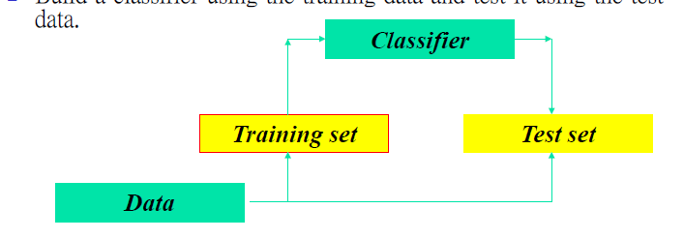
Performance evaluation
Training data set하고 testing data set을 분리 시키자
Training dataset : accuracy가 믿을 수 없음
Independent test data set : training data set하고 test set하고 달리 해서 하는 것 ( 독립적)
Hold-out method :한 개의 data set을 2/3정도는 training, 1/3 testing

Slide 6
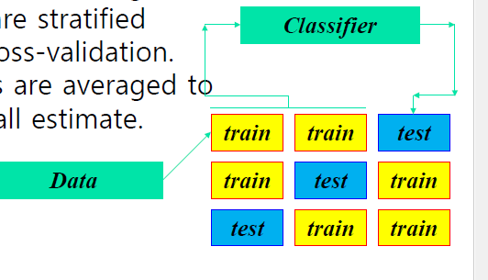
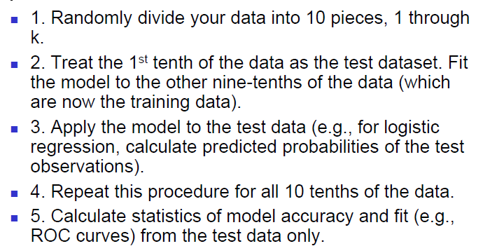
Performance evaluation
Training data set하고 testing data set을 분리 시키자
4) K-fold cross-validation method
:data split into k subset of equal size
Each sub set in turn is used for testing and
The remainder for training

